Slide 1
Interactive Programs with Scanner

Slide 2
Input and System.in
interactive program: Reads input from the console.
While the program runs, it asks the user to type input.
The input typed by the user is stored in variables in the code.
Can be tricky; users are unpredictable and misbehave.
But interactive programs have more interesting behavior.
Scanner: An object that can read input from many sources.
Communicates with System.in (the opposite of System.out)
Can also read from files (Ch. 6), web sites, databases, ...

Slide 3
Scanner syntax
The Scanner class is found in the java.util package.
import java.util.*; // so you can use Scanner
Constructing a Scanner object to read console input:
Scanner name = new Scanner(System.in);
Example:
Scanner console = new Scanner(System.in);

Slide 4
Scanner methods
Method | Description
nextInt() | reads an int from the user and returns it
nextDouble() | reads a double from the user
next() | reads a one-word String from the user
nextLine() | reads a one-line String from the user
Each method waits until the user presses Enter.
The value typed by the user is returned.
System.out.print("How old are you? "); // prompt
int age = console.nextInt();
System.out.println("You typed " + age);
prompt: A message telling the user what input to type.

Slide 5
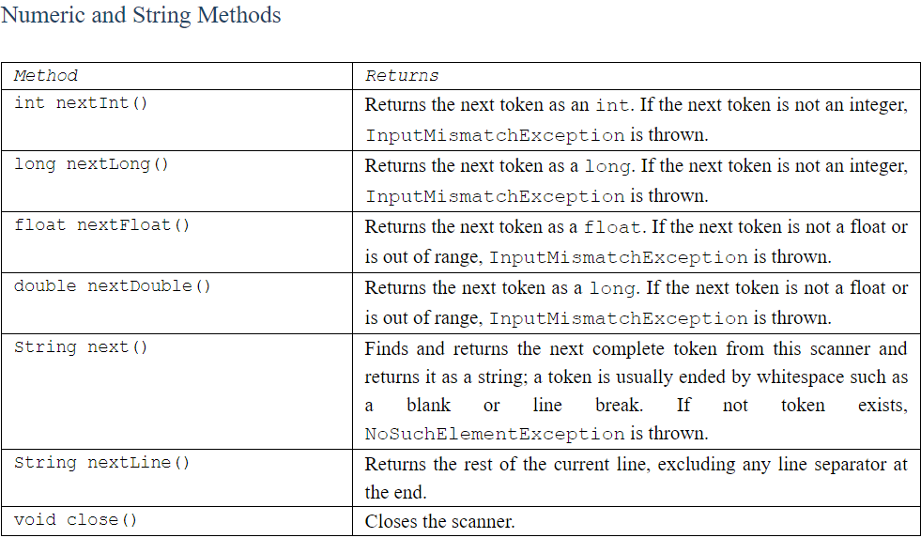
More Methods

Slide 6


Scanner example
import java.util.*; // so that I can use Scanner
public class UserInputExample {
public static void main(String[] args) {
Scanner console = new Scanner(System.in);
System.out.print("How old are you? ");
int age = console.nextInt();
int years = 65 - age;
System.out.println(years + " years to retirement!");
}
}
Console (user input underlined):
How old are you?
36 years until retirement!
age | 29
years | 36
29
Notes:
It's also useful to write a program that prompts for multiple values, both on the same line or each on its own line.

Slide 7
Scanner example 2
import java.util.*; // so that I can use Scanner
public class ScannerMultiply {
public static void main(String[] args) {
Scanner console = new Scanner(System.in);
System.out.print("Please type two numbers: ");
int num1 = console.nextInt();
int num2 = console.nextInt();
int product = num1 * num2;
System.out.println("The product is " + product);
}
}
Output (user input underlined):
Please type two numbers: 8 6
The product is 48
The Scanner can read multiple values from one line.
Notes:
It's also useful to write a program that prompts for multiple values, both on the same line or each on its own line.

Slide 8
Input tokens
token: A unit of user input, as read by the Scanner.
Tokens are separated by whitespace (spaces, tabs, new lines).
How many tokens appear on the following line of input?
23 John Smith 42.0 "Hello world" $2.50 " 19"
When a token is not the type you ask for, it crashes.
System.out.print("What is your age? ");
int age = console.nextInt();
Output:
What is your age? Timmy
java.util.InputMismatchException
at java.util.Scanner.next(Unknown Source)
at java.util.Scanner.nextInt(Unknown Source)
...

Slide 9
Strings as user input
Scanner's next method reads a word of input as a String.
Scanner console = new Scanner(System.in);
System.out.print("What is your name? ");
String name = console.next();
name = name.toUpperCase();
System.out.println(name + " has " + name.length() +
" letters and starts with " + name.substring(0, 1));
Output:
What is your name? Chamillionaire
CHAMILLIONAIRE has 14 letters and starts with C
The nextLine method reads a line of input as a String.
System.out.print("What is your address? ");
String address = console.nextLine();

Slide 10
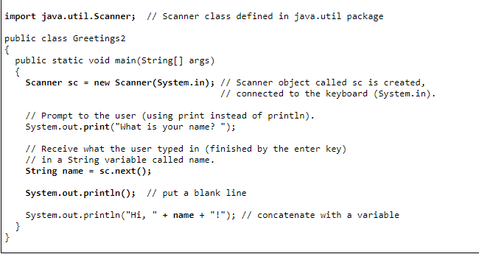

Slide 11
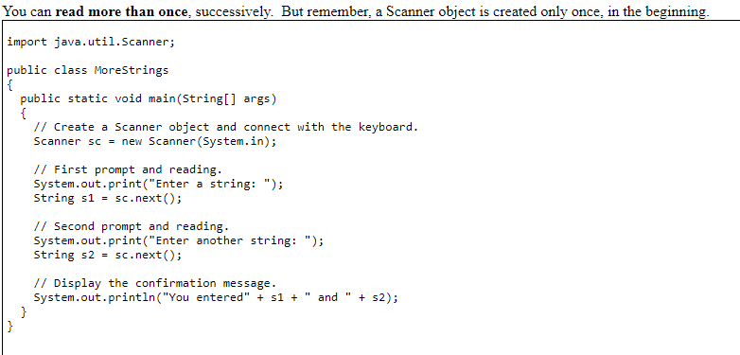

Slide 12
Strings question
Write a program that outputs a person's "gangsta name."
first initial
Diddy
last name (all caps)
first name
-izzle
Example Output:
Type your name, playa: Marge Simpson
Your gangsta name is "M. Diddy SIMPSON Marge-izzle"

Slide 13
Strings answer
// This program prints your "gangsta" name.
import java.util.*;
public class GangstaName {
public static void main(String[] args) {
Scanner console = new Scanner(System.in);
System.out.print("Type your name, playa: ");
String name = console.nextLine();
// split name into first/last name and initials
String first = name.substring(0, name.indexOf(" "));
String last = name.substring(name.indexOf(" ") + 1);
last = last.toUpperCase();
String fInitial = first.substring(0, 1);
System.out.println("Your gangsta name is \"" + fInitial +
". Diddy " + last + " " + first + "-izzle\"");
}
}

